Slide 1
Atmospheric Chemistry and Deposition
World-class measurements and models for
air quality decision-makers, forecasters, and the research community
LaToya Myles
Air Resources Laboratory June 22, 2016

Slide 2
Atmospheric Chemistry and Deposition R&D
Our R&D considers the emissions, transformation, transport, and fate of important atmospheric pollutants known to have an impact on human health and/or the environment.
These specific pollutants:
Contribute to poor air quality
Contribute to ecosystem decline
Are associated with many emissions sources, and
Are significantly influenced by chemical transformations
Atmospheric
Chemistry &
Deposition
Notes:
ARL’s research and development activities are targeted on air quality and the emissions, transformation, transport, and fate of chemical pollutants from both natural and anthropogenic sources.

Slide 3
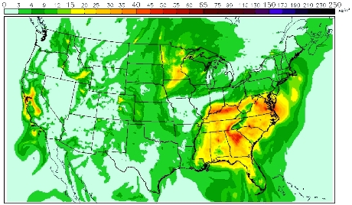
R&D Goal Advance scientific understanding and predictive modeling capabilities of the emission, transport, chemical transformation, and air-surface exchange of air pollutants that impact human and ecosystem health
Research Priorities
Improvement in model predictions of surface ozone and PM
Atmospheric Deposition
Mercury Modeling and Monitoring
Notes:
ARL’s research and development seeks to advance scientific understanding and predictive modeling capabilities of atmospheric pollutants, from emission through transport and ultimately to chemical transformation or air-surface exchange.

Slide 4
R&D Drivers
Research Enterprise
1. Agreements with other agencies (e.g. U.S. EPA, NPS)
2. Leadership in International Efforts (e.g. World Met. Organization)
3. Partnerships with academia (e.g. U of Maryland, U of Illinois)
NOAA Priorities
1. NOAA 5-year R&D Plan
2. OAR Strategic Plan
3. National Ocean Policy
Mandates
1. 1990 Clean Air Act Amendments (e.g. Title IV Acid Deposition Control and Title IX Clean Air Research)
2. Harmful Algal Bloom and Hypoxia Research Control Act
Notes:
ARL’s atmospheric chemistry and deposition program is driven by the research enterprise, international scientific efforts, and collaborations with academic institutions across the country. ARL aligns research with NOAA’s research priorities and with federal mandates.

Slide 5
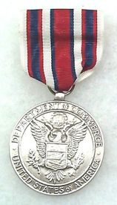
Quality: Awards
2011
Daniel Tong: US EPA Science and Technology Achievement Award, Level II and Honorable Mention (two awards)
2012
Rick Saylor: Best Reviewer for Journal of the Air and Waste Management Association
2013
Winston Luke: Department of Commerce Silver Medal Award for Meritorious Federal Service
2014
Pius Lee: OAR Employee of the Year Award
2016
LaToya Myles: OAR EEO/Diversity Award for Exemplary Service
Notes:
ARL scientists have received recognition from NOAA, other federal agencies, and from the scientific community.

Slide 6
Quality: Publications
2010-2015 ARL Atmospheric Chemistry and Deposition Publications
Total = 95
Average = 16 per year
Notes:
Since 2010, ARL chemistry and deposition research has produced 95 publications in peer-reviewed literature.

Slide 7
Quality: Publications

Slide 8
Quality: Technology Transfer
Model Products for NOAA National Air Quality Forecasting Capability
Improved basis for air quality alerts
Air quality information for communities at risk
2004: Ozone
NCEP Predictions
Ozone nationwide
Smoke nationwide
Dust over CONUS
PM_{2.5} over CONUS
2007: Ozone
and smoke
2012: Dust
2016: PM_{2.5}
2005: Ozone
2010: Ozone and smoke
Notes:
The National Weather Service’s National Centers for Environmental Prediction utilize tools that ARL develops for predictions of ozone, smoke, dust and particulate matter over different regions across the nation.

Slide 9
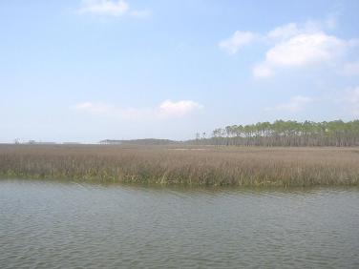
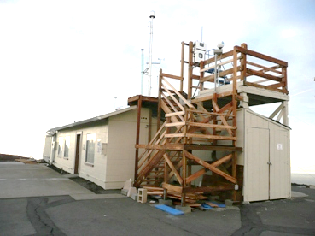
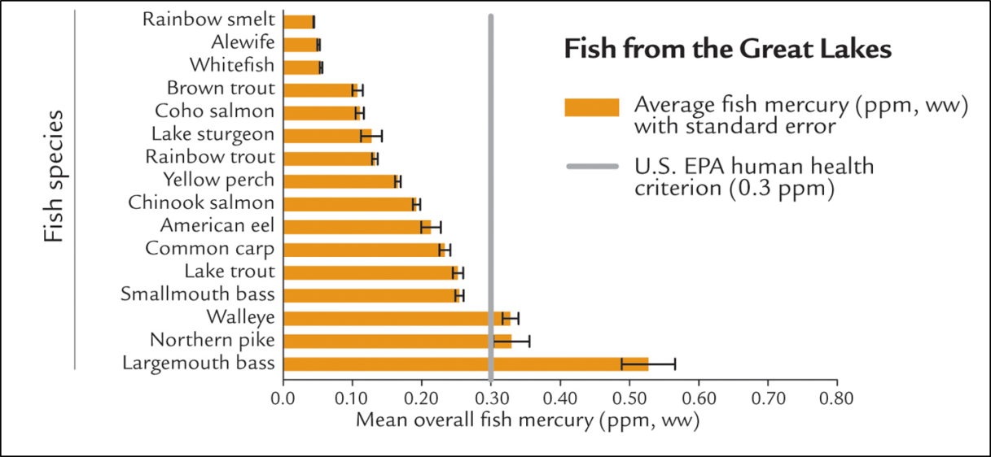
Quality: Technology Transfer
Mercury Program – Measurements
Mercury Program - Models
Notes:
ARL’s mercury program includes a state-of-the-art modeling system that tracks mercury emission sources. ARL also conducts long-term process studies and monitoring of mercury in ambient air at Mauna Loa, Hawaii; Grand Bay, MS; and Beltsville, MD.

Slide 10
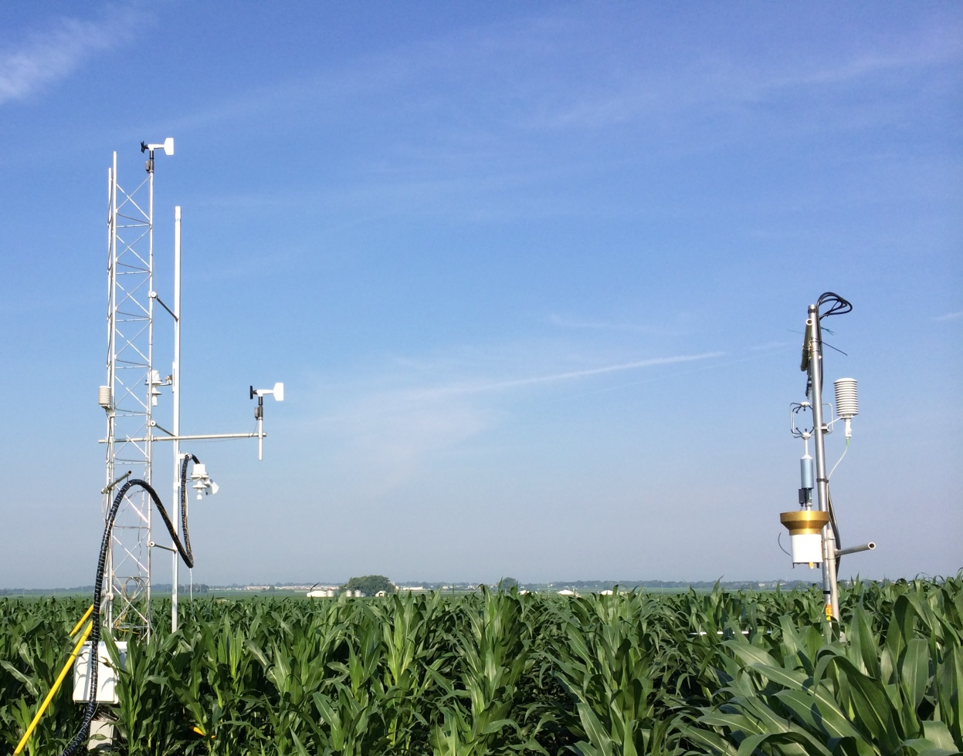
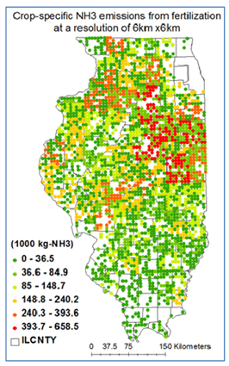
Relevance: Products and Information
Nitrogen Program – Measurements
Crop-specific NH₃ emission from fertilization
Crop
Animal
Soil
Agroecosystem Effects
Notes:
ARL conducts short-term field studies to test emerging chemical measurement technologies and improve the understanding of the atmospheric and terrestrial processes and factors that control air-surface exchange of these compounds.

Slide 11
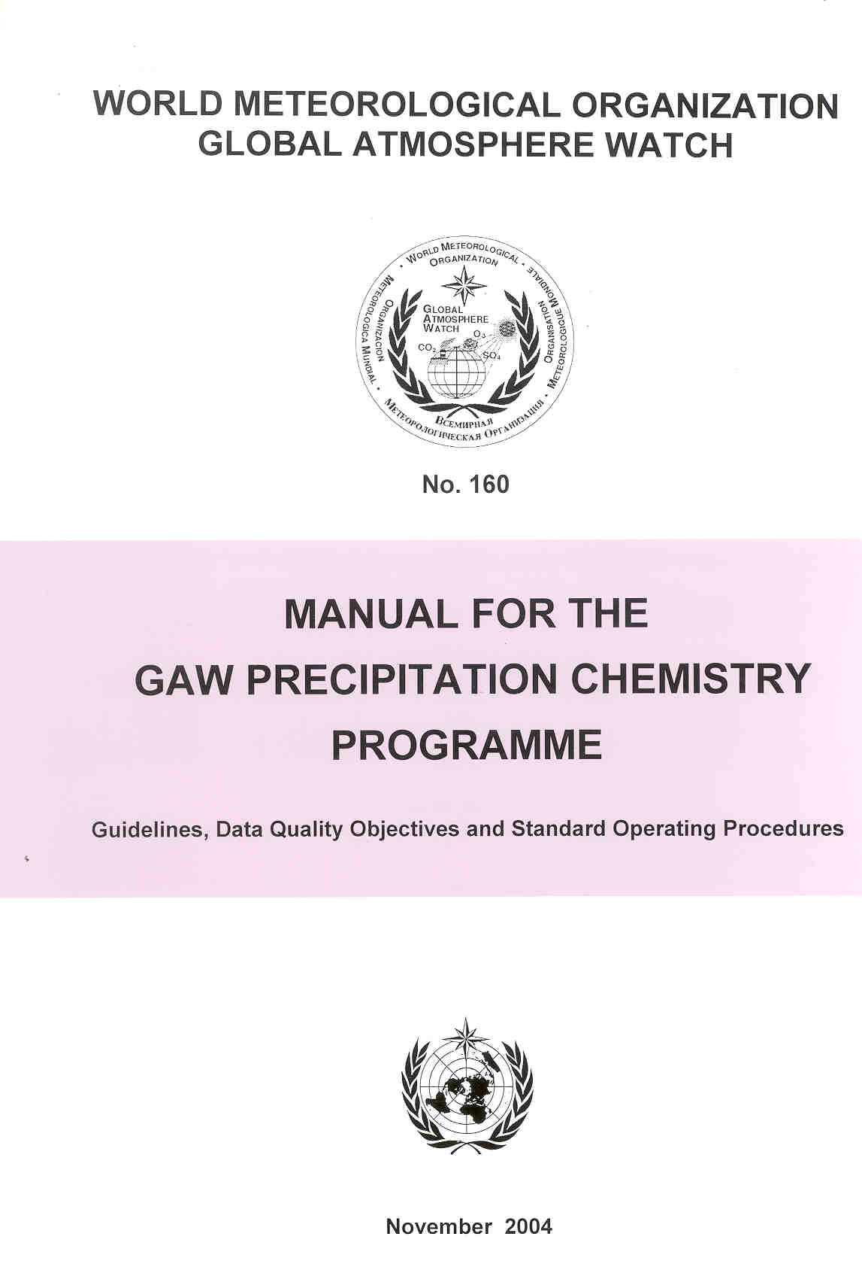
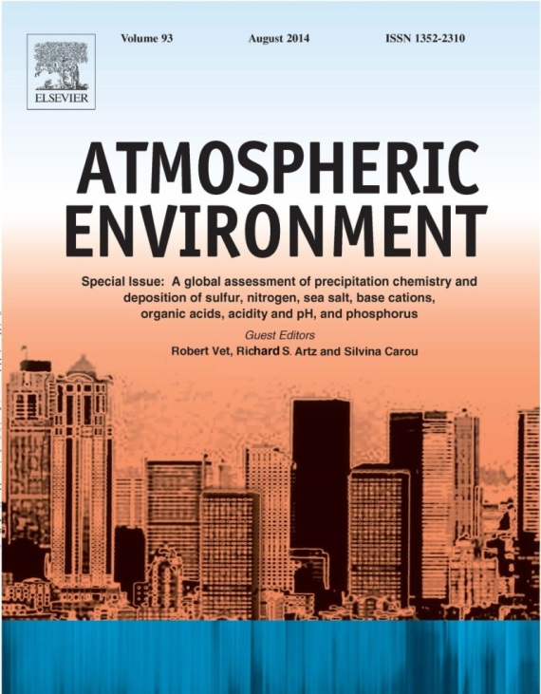
Relevance: International Assessment
World Meteorological Organization
Precipitation Chemistry Science Advisory Group
Notes:
On a larger scale, ARL has a leading role in the World Meteorological Organization’s Precipitation Chemistry Science Advisory Group, which addresses concerns over acid deposition, eutrophication, trace metal deposition, ecosystem health, biogeochemical cycling, and global climate change.

Slide 12
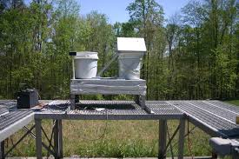
Relevance: Deposition Network
Notes:
ARL operates the Atmospheric Integrated Research Monitoring Network, which is a daily wet deposition collection network consisting of six sites in the eastern US. As part of the National Atmospheric Deposition Program, AIRMoN provides historical precipitation data that is useful for investigation of long-term trends and assessments of policy implementation for a suite of chemical pollutants.

Slide 13
Mercury Concentration, 2014
Notes:
These maps provide a snapshot of the types of national networks that ARL actively contributes data and information to.

Slide 14
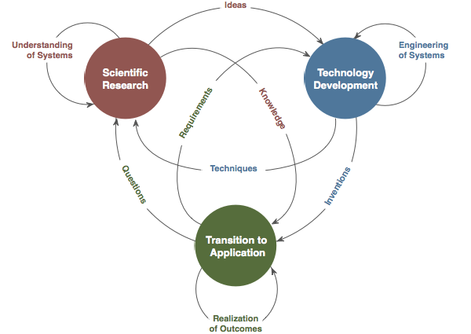
Performance: Research Transitions
NOAA National Air Quality Forecasting Capability updates successfully moved into NWS operations annually beginning in 2004.
Mercury measurement methodologies accepted as the international standard.
Mercury model used to set environmental policy in the Great Lakes Region.
Nitrogen data used to understand spatial patterns of agricultural emissions.
Assessment publication from Global Atmosphere Watch Precipitation Chemistry Science Advisory Group still in top 10 most downloaded articles two years after publication.
Notes:
ARL transitions key aspects of its research to operations. For example, ARL transitions National Air Quality Forecast Capability updates to National Weather Service operations and mercury model output to policymakers in the Great Lakes region.

Slide 15
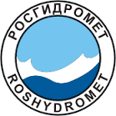
Performance: Collaborations

Slide 16
Atmospheric Chemistry and Deposition Presentations
Air Quality Forecast Modeling
Emissions Modeling
Surface-Atmosphere Exchange Modeling
Pius Lee
Daniel Tong
Rick Saylor
Atmospheric Mercury Modeling
Mark Cohen
Atmospheric Mercury Measurements
Winston Luke
Atmospheric Deposition
ARL Contributions to the WMO Atmospheric Deposition Program
LaToya Myles
Rick Artz
8:45
9:10
9:35
10:00
10:25 Break
10:40
11:05
11:25
11:45 Q&A Session

Slide 17
ACD E-Posters
TV # | Time | Title | Presenter
1 | 3:15 & 3:30 | Assessment of Measurement Artifacts of Atmospheric Mercury Species | Winston Luke
1 | 3:45 & 4:00 | Satellite Retrievals of Marine Emissions | Daniel Tong
2 | 3:15 & 3:30 | OMI NO₂ Column Densities over North American Urban Cities: The Effect of Satellite Footprint Resolution | HyunCheol Kim
2 | 3:45 & 4:00 | Land Surface Modeling and Implications to Air Quality and Climate Change | Pius Lee
3 | 3:15 & 3:30 | Improved Calibration Methodologies for Atmospheric Mercury Measurements | Paul Kelley
3 | 3:45 & 4:00 | Atmospheric Mercury Measurements at the Beltsville Site in Maryland: Trends and Source-Receptor Correlation | Xinrong Ren
4 | 3:45 & 4:00 | A New Way to Couple the CMAQ Model Using the National Unified Operational Prediction Capability (NUOPC) Framework | Barry Baker

Slide 18
Atmospheric Chemistry and Deposition
World-class measurements and models for
air quality decision-makers, forecasters, and the research community

